Slide 1
A Geologist in Afghanistan
The adventures of a foolish geoscientist?
James P. Llorca
FAIG, FAusIMM(CP), FSEG
Team Leader – Component II
Mineral Exploration & Capacity Development
USAID – MIDAS Project
(Mining Investment & Development for Afghan Sustainability)

Slide 2
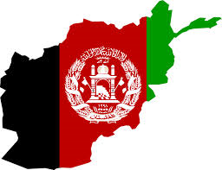
TOPIC OUTLINE
What the ____ are you doing in Afghanistan?
Where is Afghanistan?
Okay, tell me about that country, Afghanistan.
What are the mineral resources in Afghanistan?
All right, show me some photos.
Q & A
Have a toast for me…
Notes:
Have a toast for me: That is because Afghanistan is a practising Islam country and alcohol and pork are banned. I am at a dry camp. But there are counter measures to circumvent this restrictions.

Slide 3
JAMES YOU A FOOL?
Why are you going to Afghanistan? It is either you are extremely brave of foolish.
  I think I am both.
So, why am I here?
  A chance to make a difference and help a country in need
  The geology is a new experience, pioneering new area
  It is a new frontier for me, the country has enormous potential resources
  The pay is good but high risk.
Notes:
Have a toast for me: That is because Afghanistan is a practising Islam country and alcohol and pork are banned. I am at a dry camp. But there are counter measures to circumvent this restrictions.

Slide 4
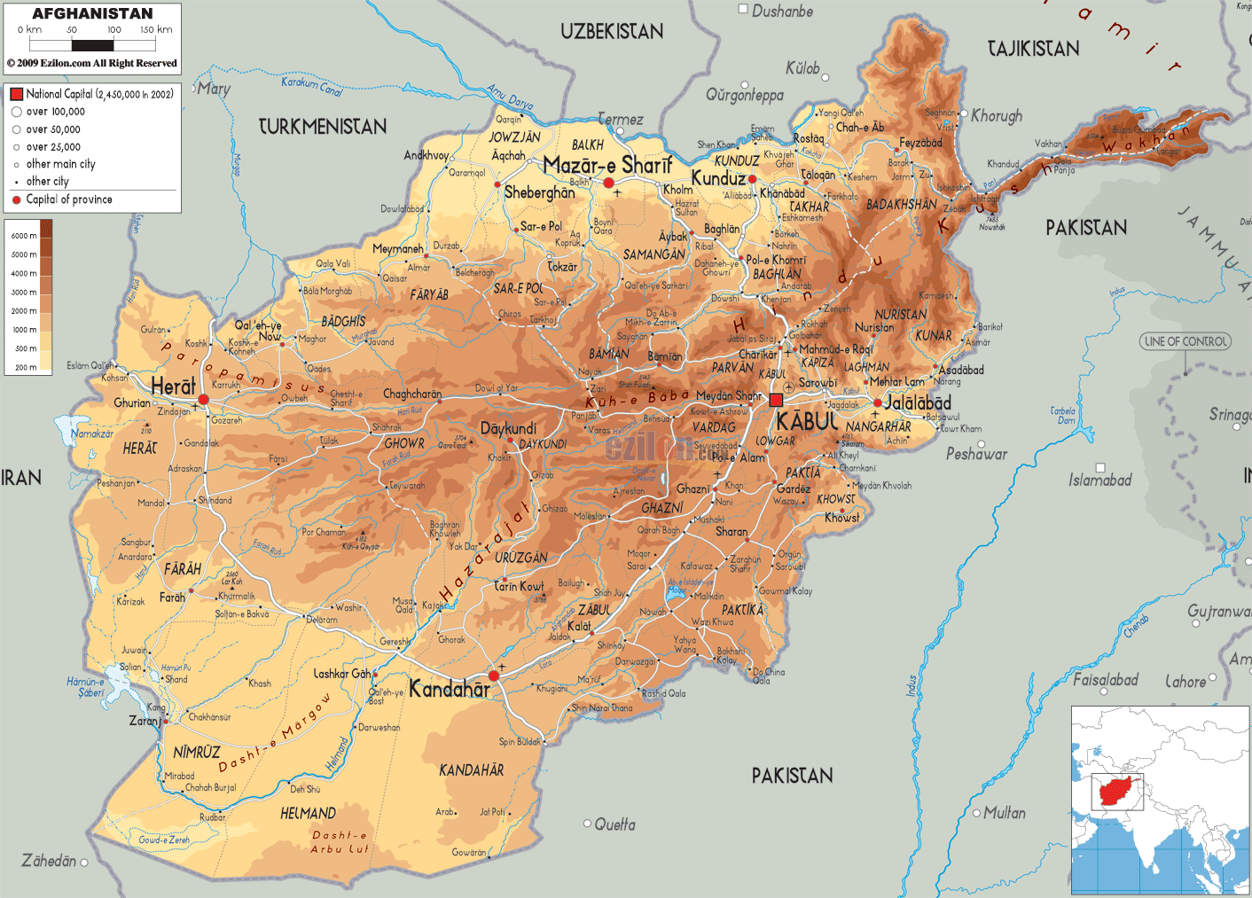
Islamic Republic of Afghanistan

Slide 5
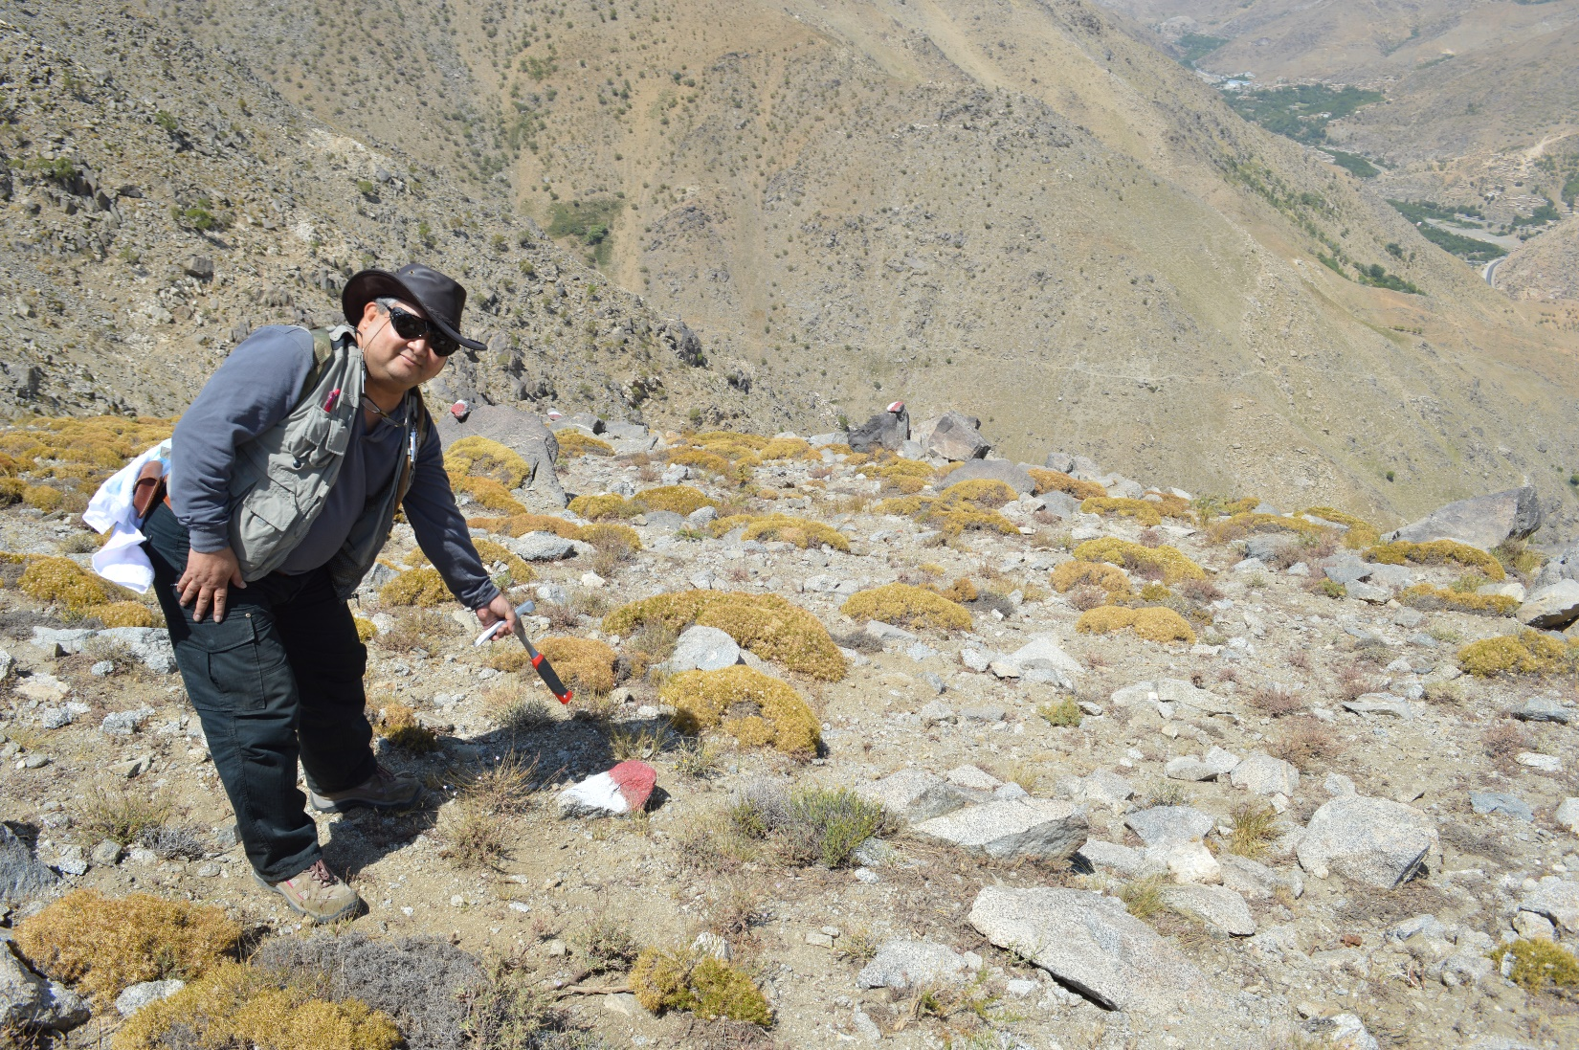
Mines of Afghanistan ---- Land Mines!!!

Slide 6
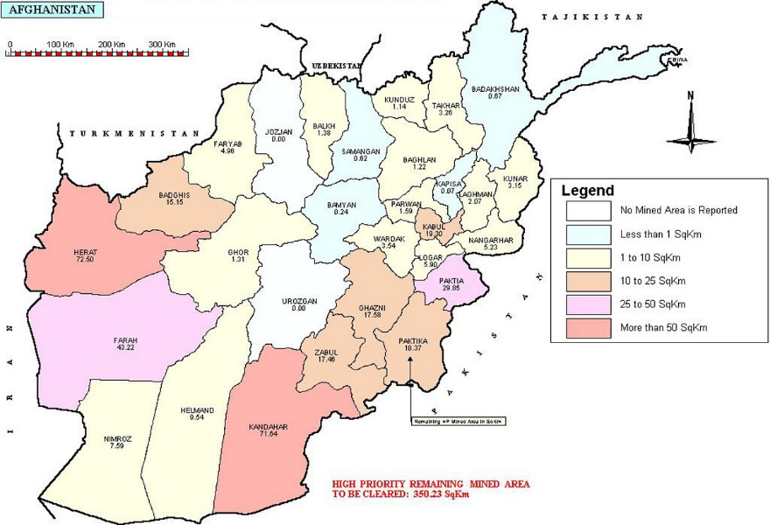
Where are these mines?

Slide 7
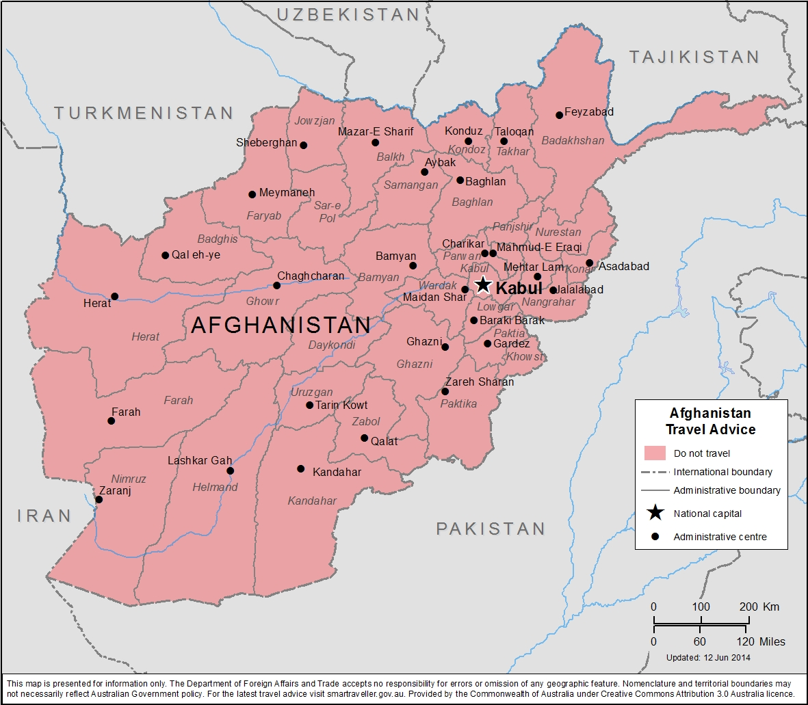
Islamic Republic of Afghanistan – Travel Advise

Slide 8
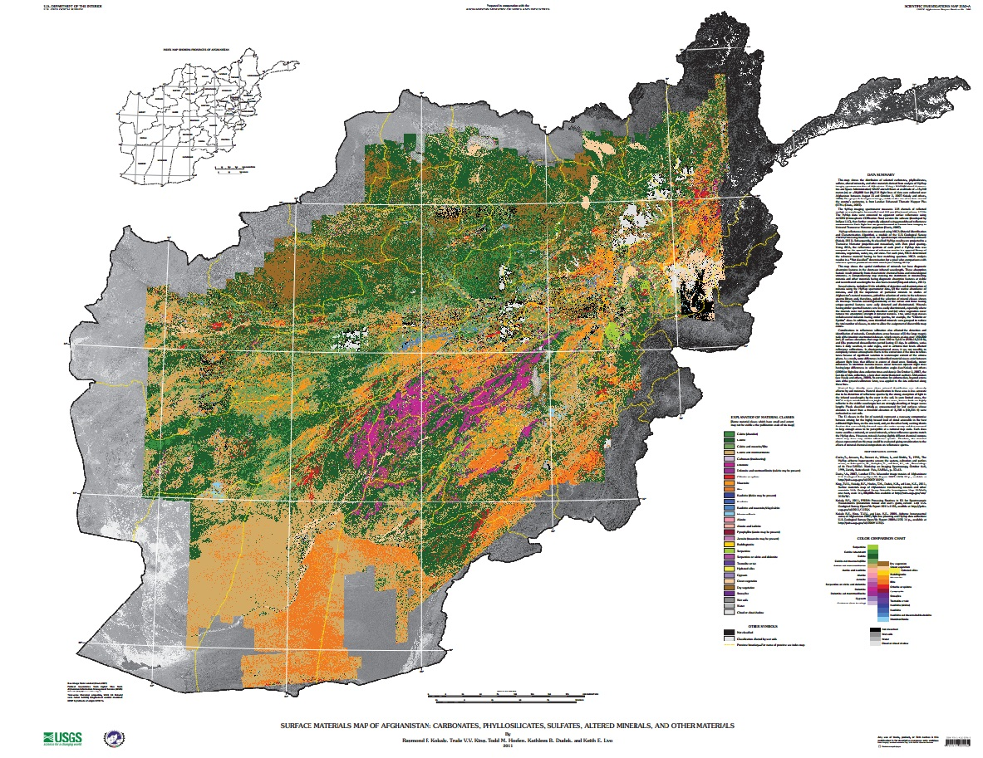
Hyperspectral Data Coverage

Slide 9
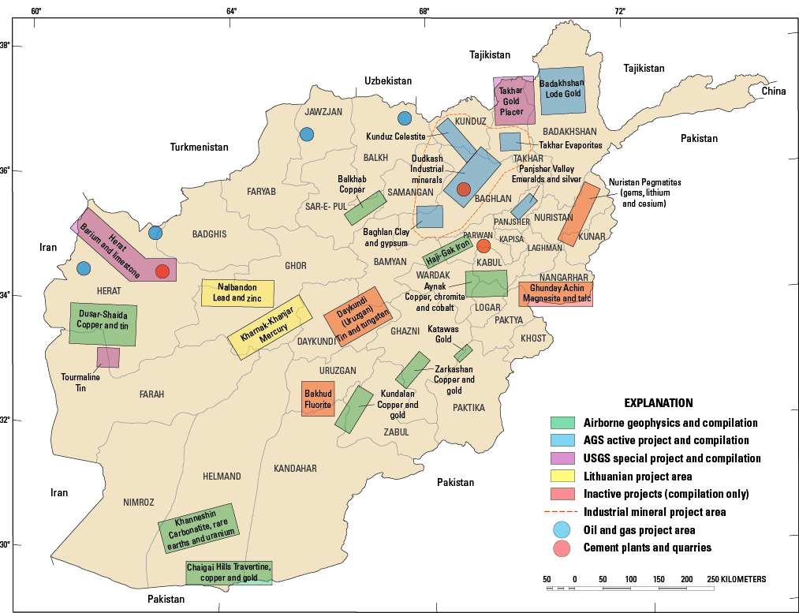
Resources Project Areas

Slide 10
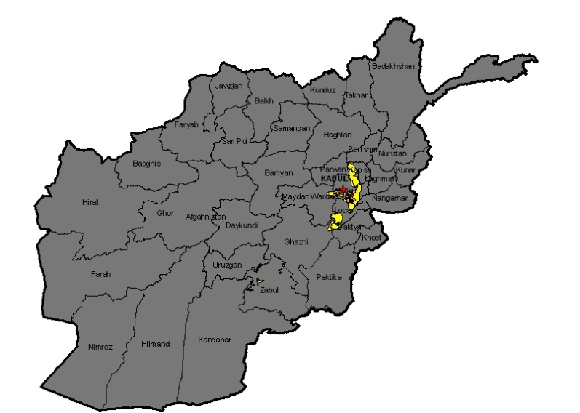
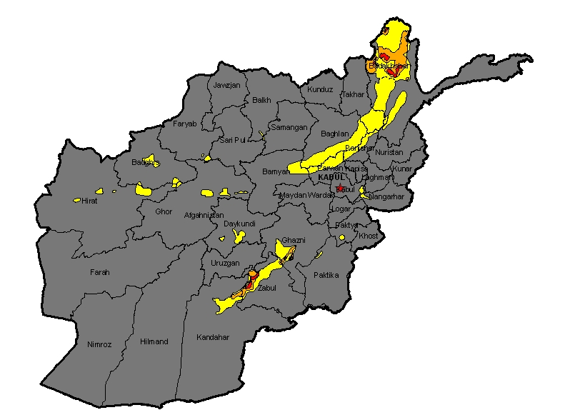
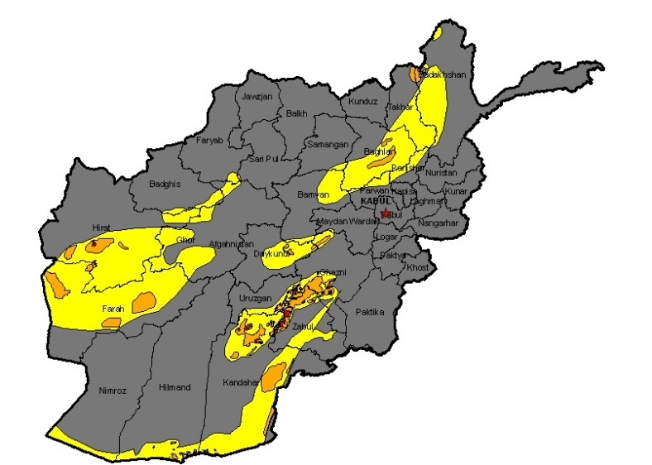
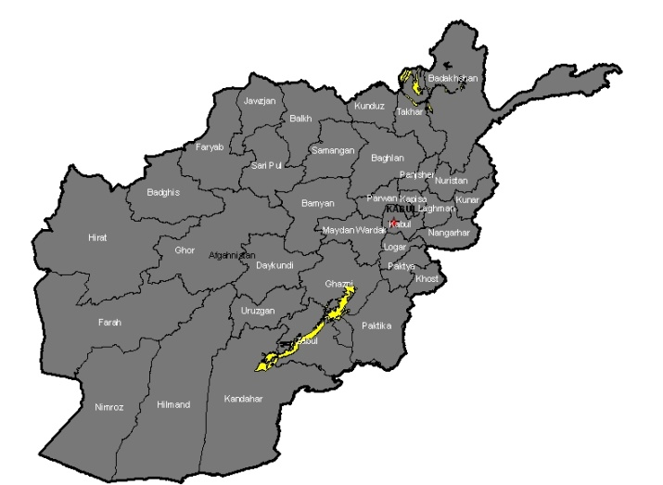
Copper & Gold Prospectivity
Sedimentary Copper
Load Gold
Porphyry Copper
Placer Gold

Slide 11
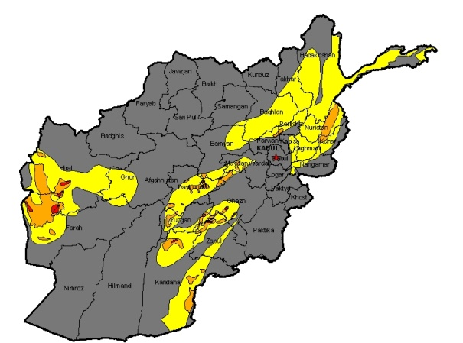
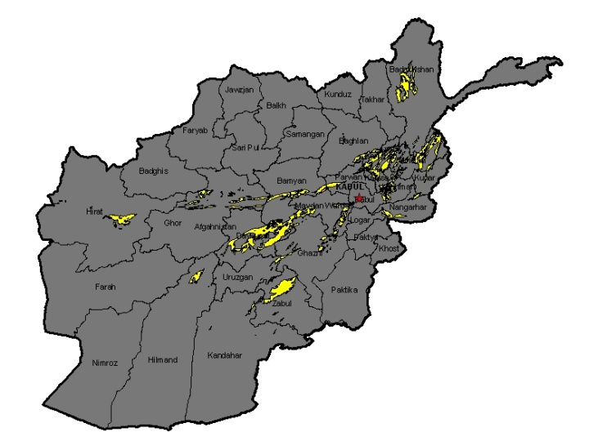
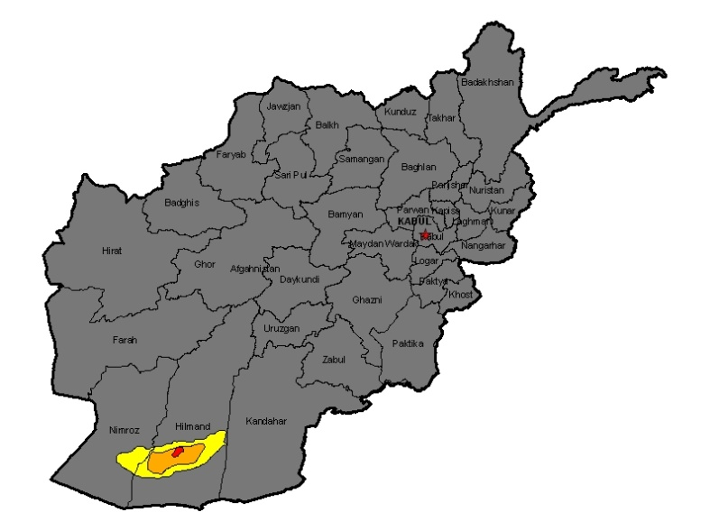
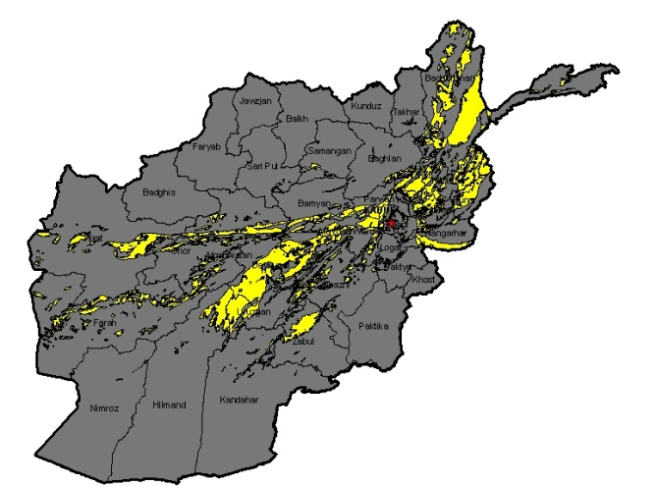
Sn-W, RRE, Fe, Pb-Zn Prospectivity
Tin and Tungsten
Sedimentary Iron
Rare Earth Elements
Zn-Pb

Slide 12
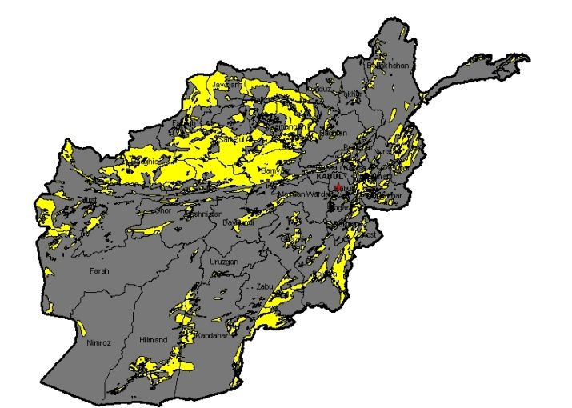
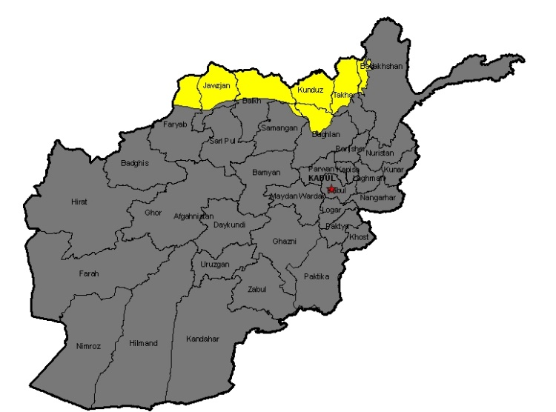
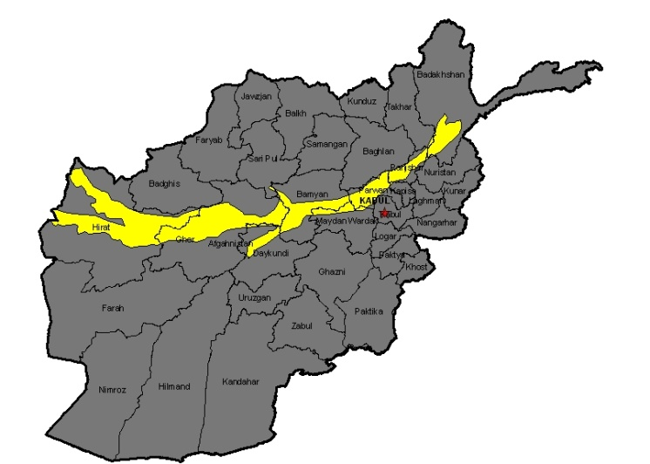
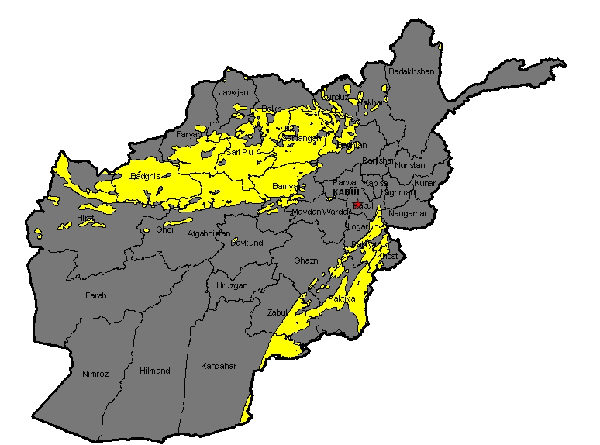
Borates, Barite, Salt-Potash & S Prospectivity
Borates
Salt and Potash
Barite
Sulfur

Slide 13
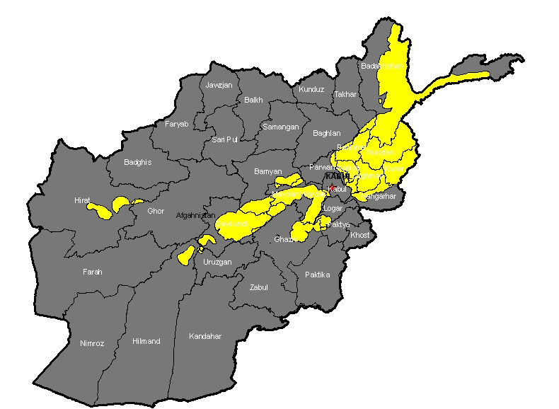
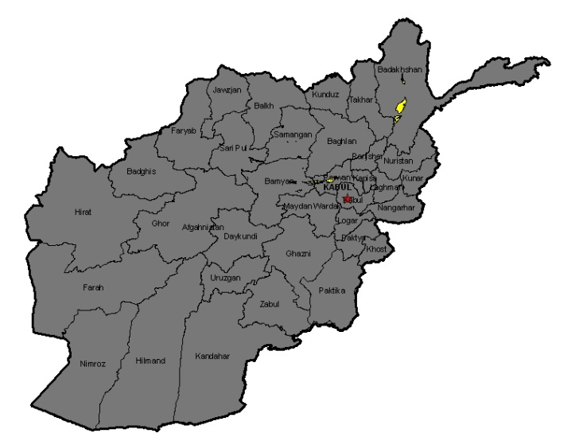
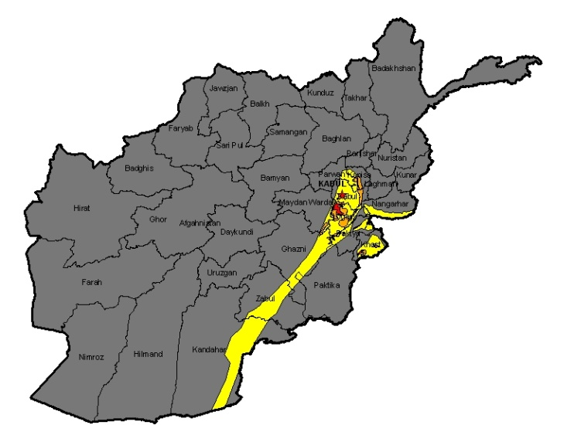
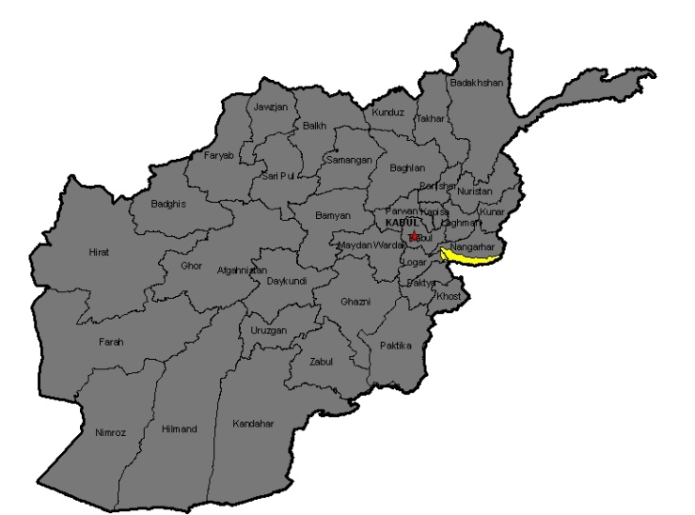
Mn, Ta, Nb, Cr, Talc & Magnesite Prospectivity
Pegmatites with Ta,Nb,
Li, Be and gemstones
Mn
Chromite
Talc and Magnesite

Slide 14
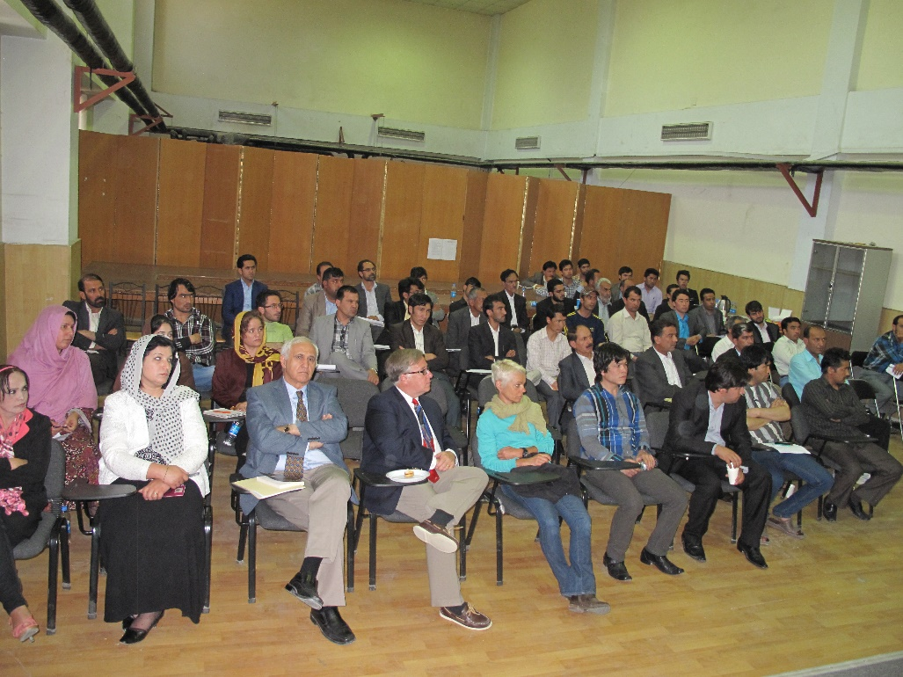
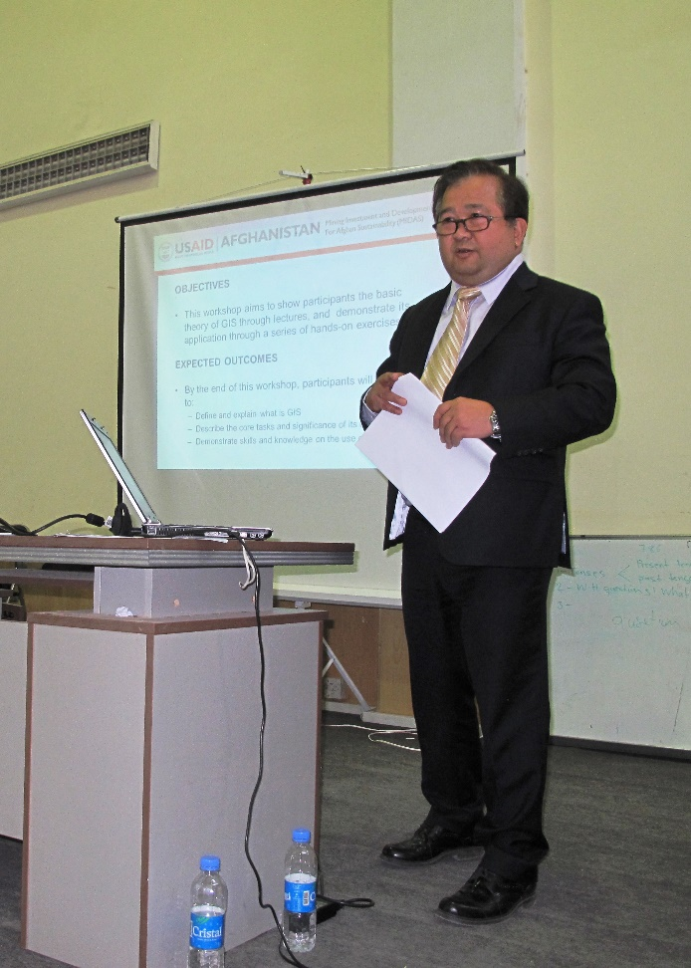
Capacity Building and Training

Slide 15
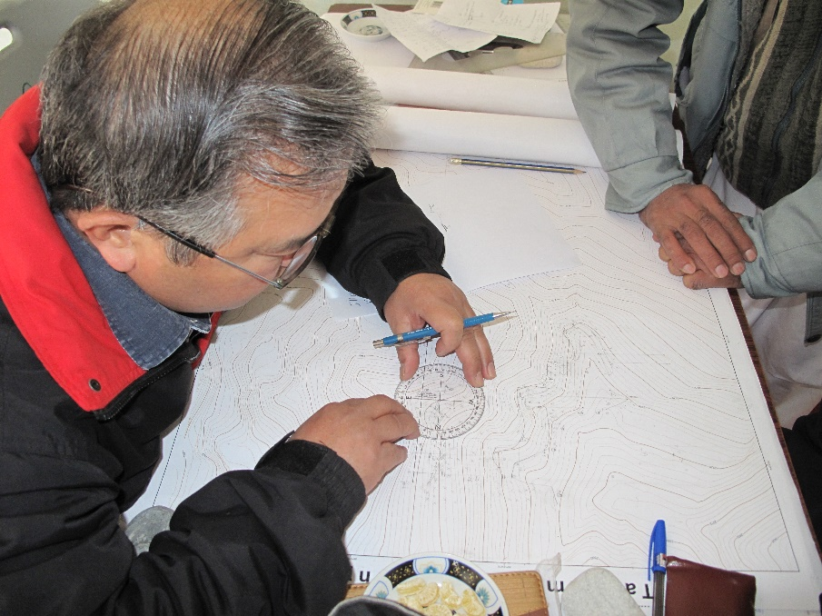
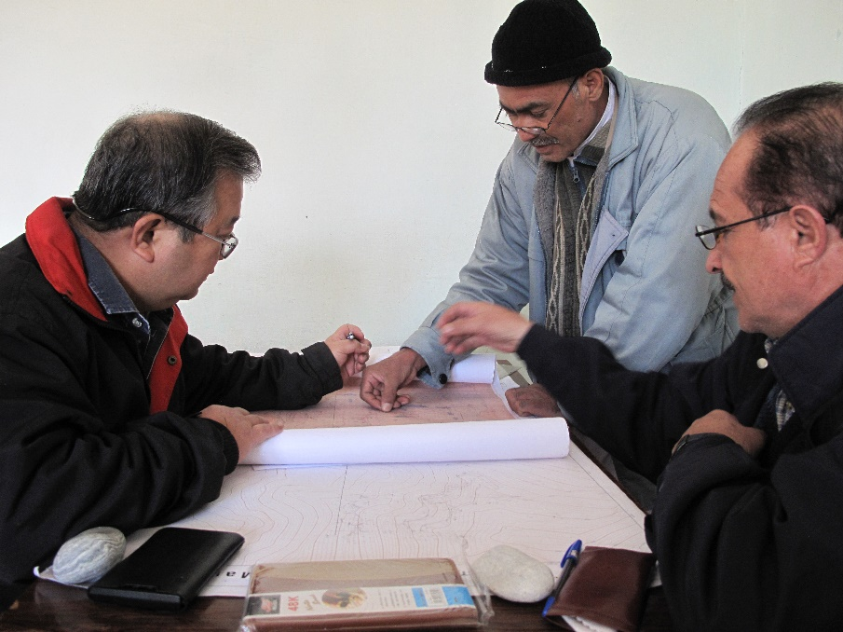
Manual plotting

Slide 16
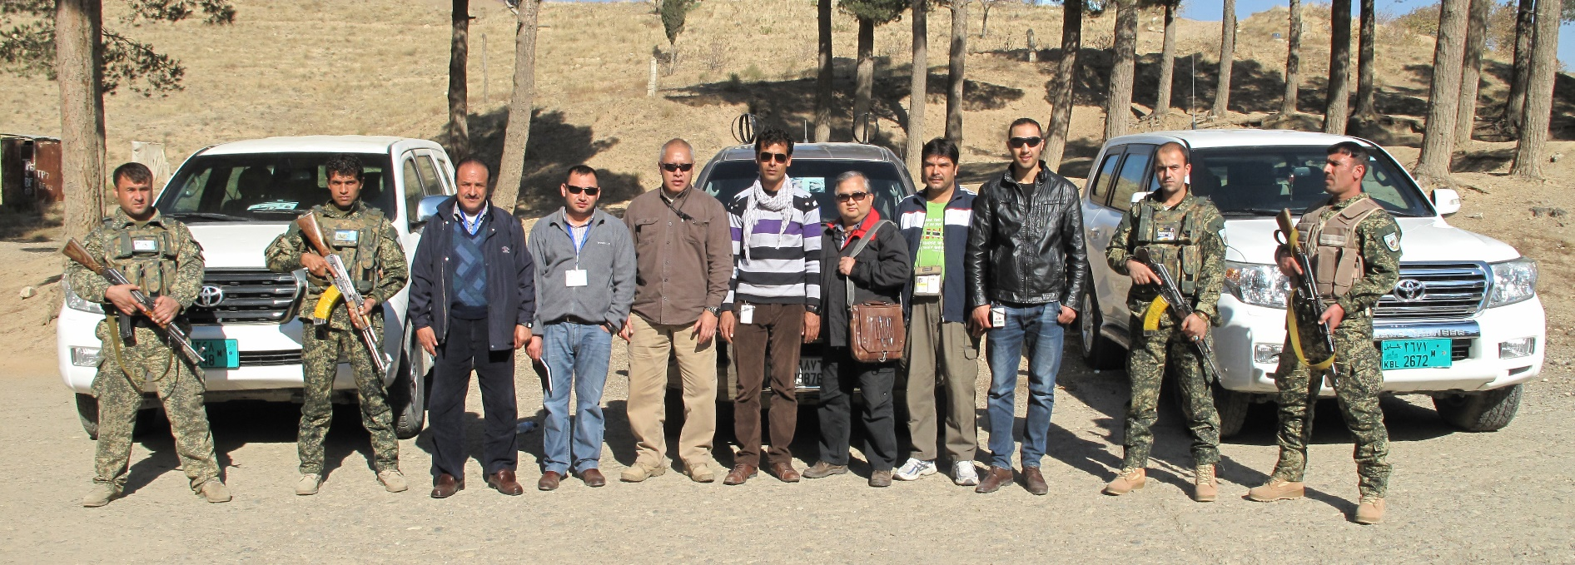
Normal Entourage

Slide 17
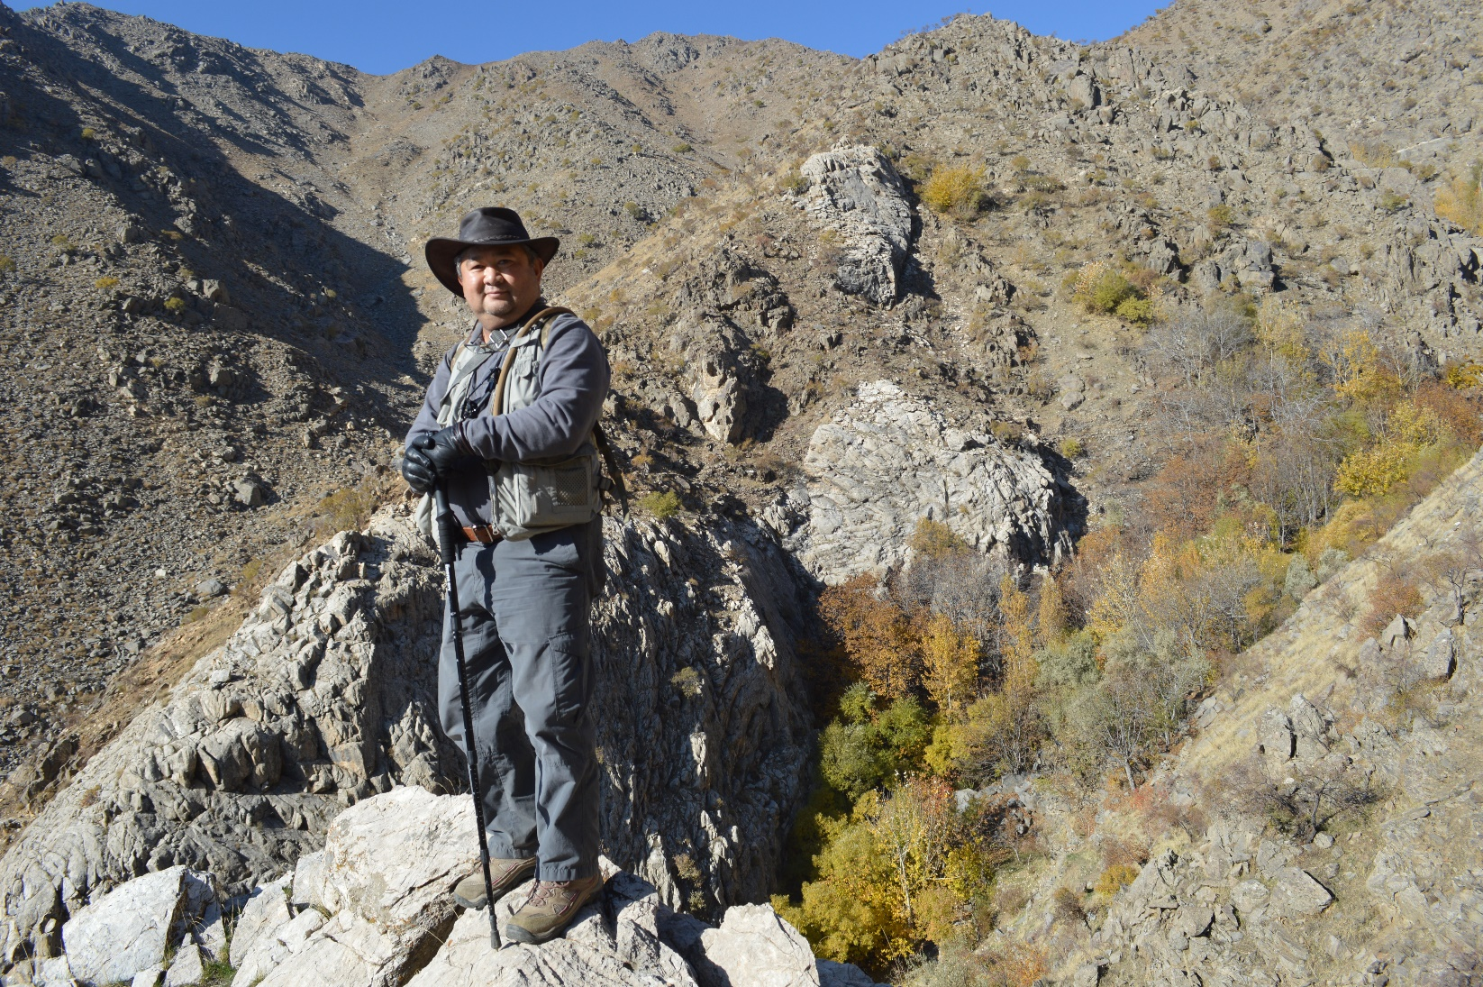
Rugged Terrain at High Altitude of +2.5Km

Slide 18
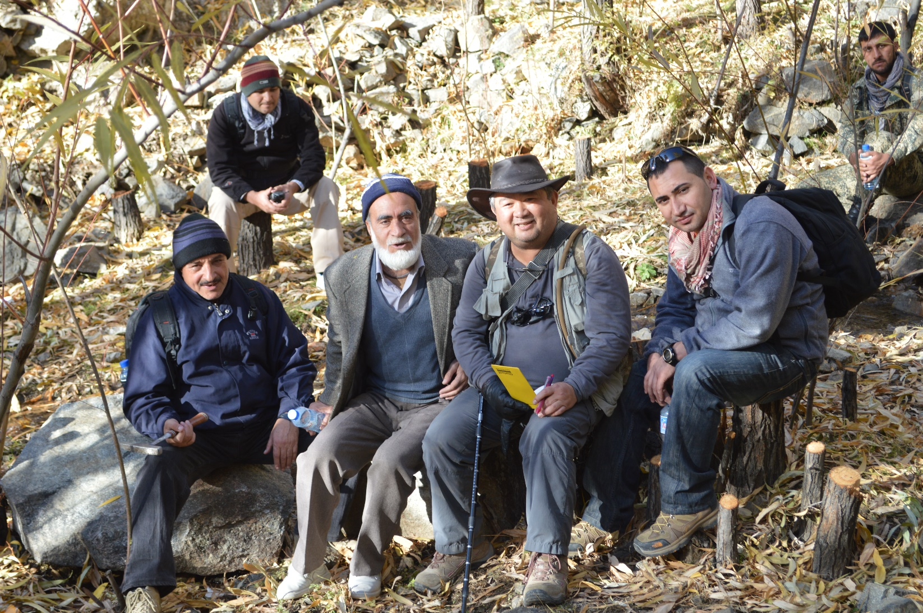
Rest Stop

Slide 19
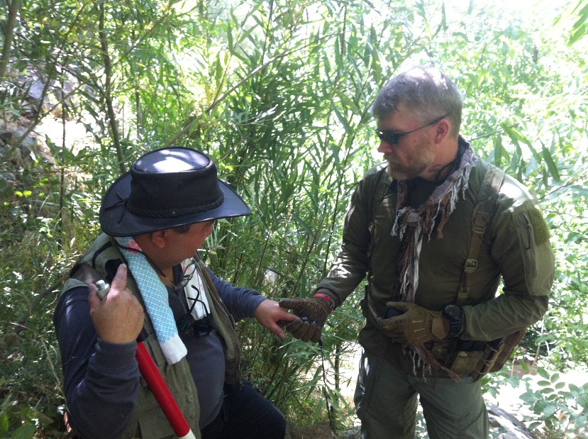
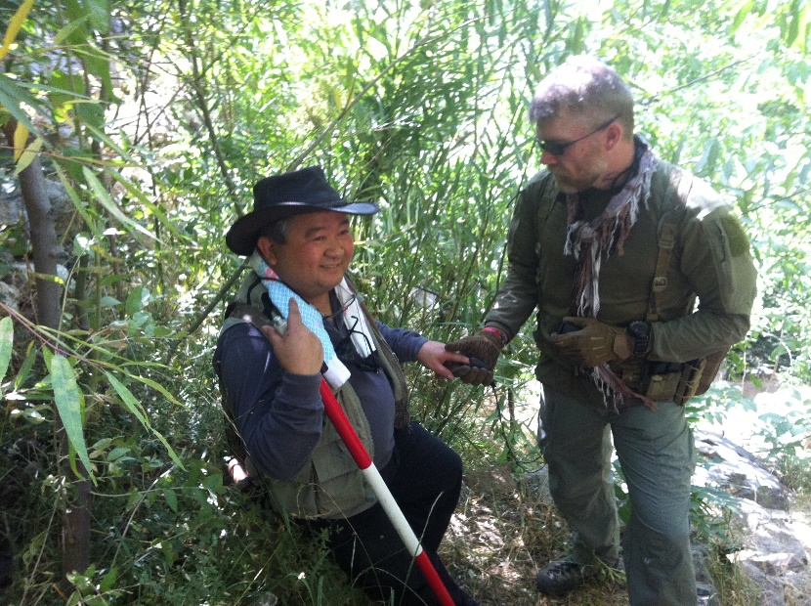
Medic checks heart rate….

Slide 20
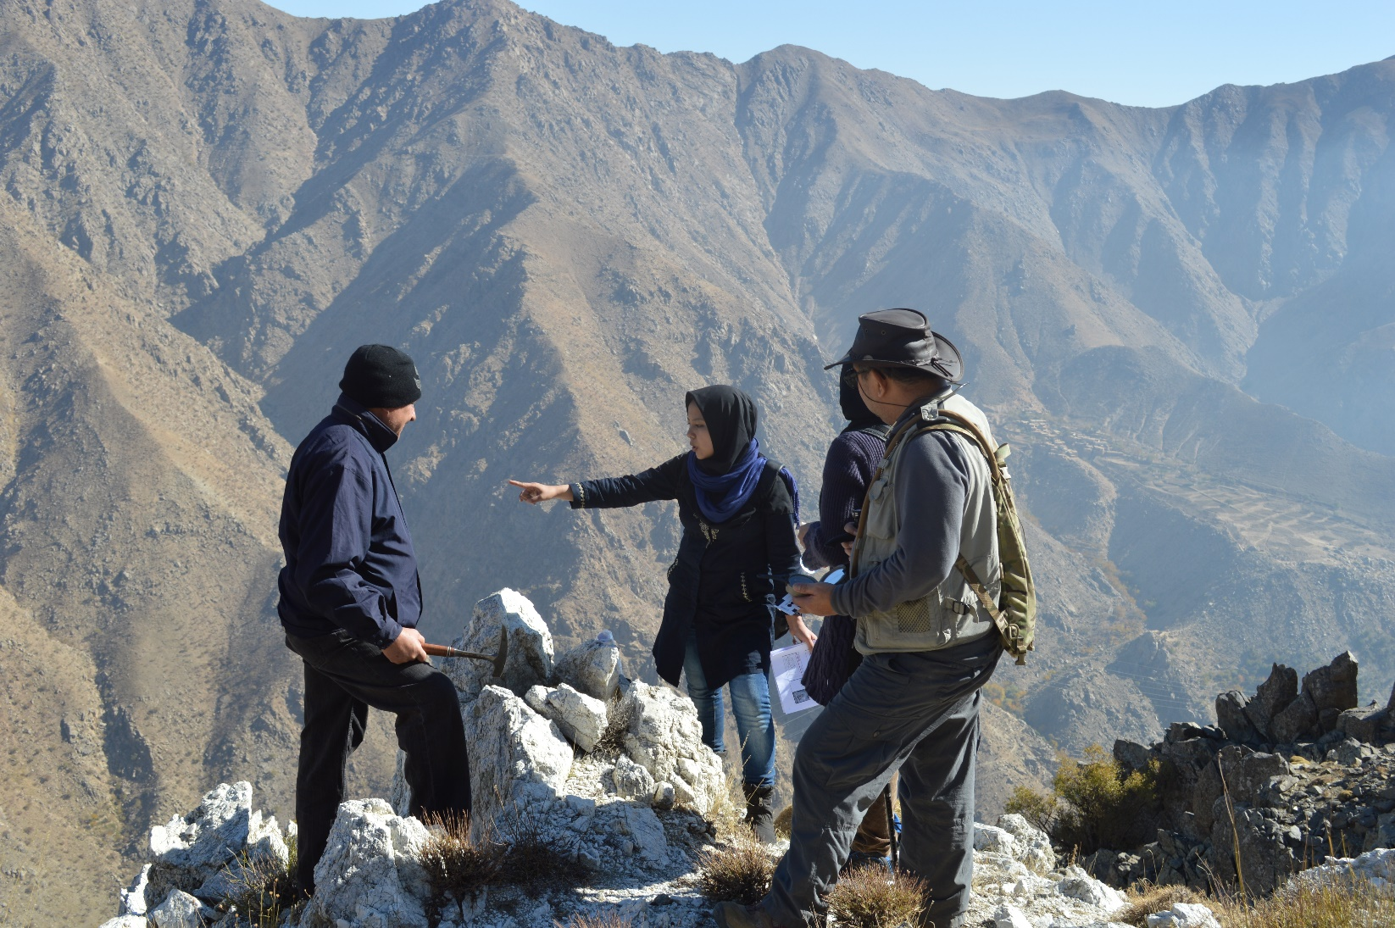
Female Afghan Geologists

Slide 21
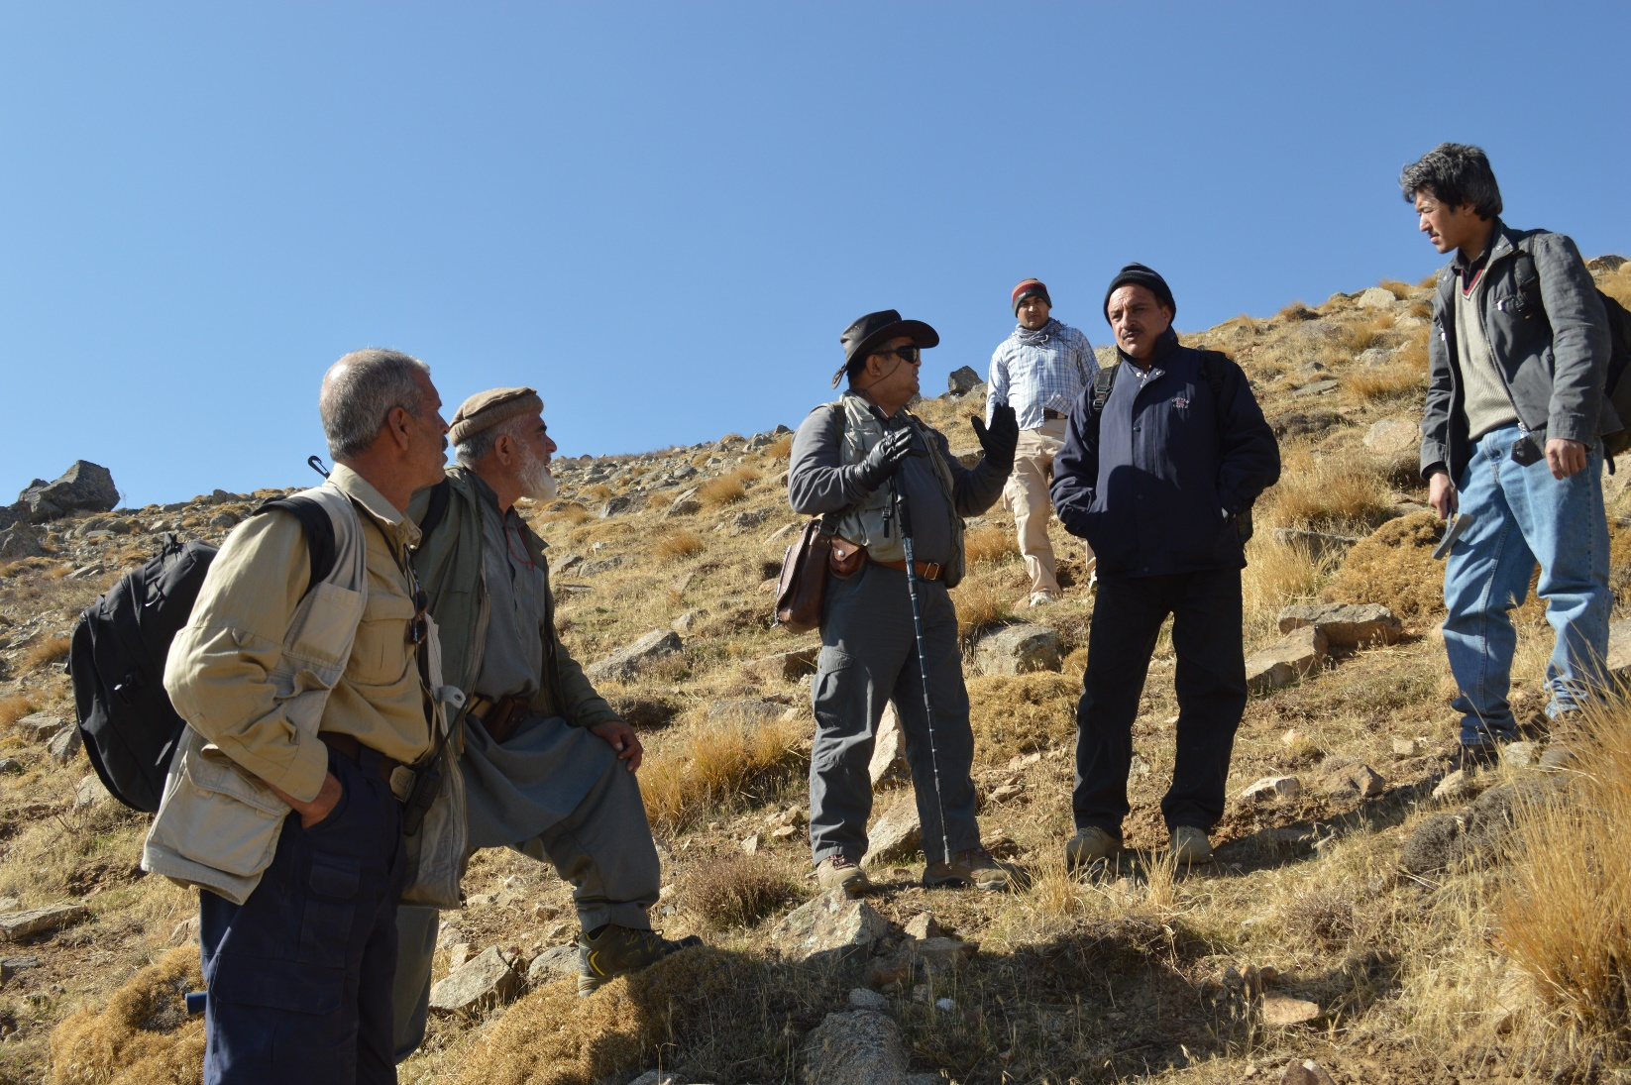
Brief lecturing on how good the weather is…

Slide 22
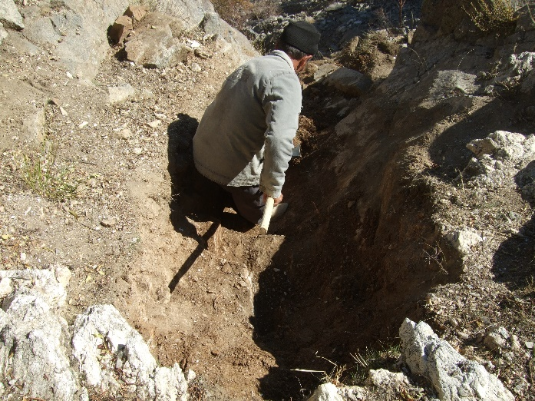
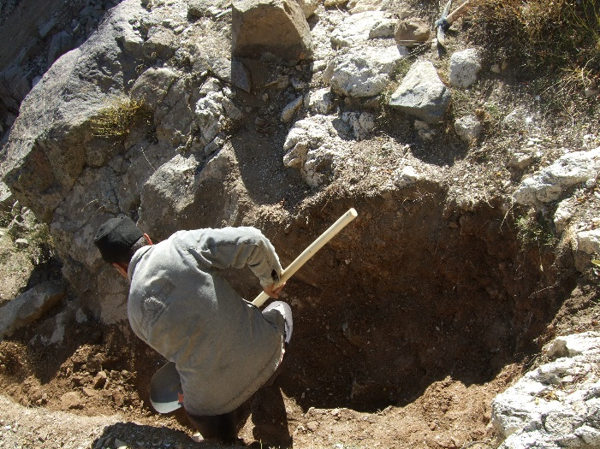
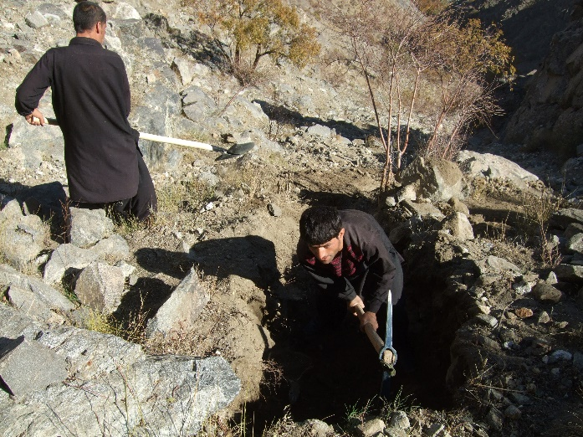
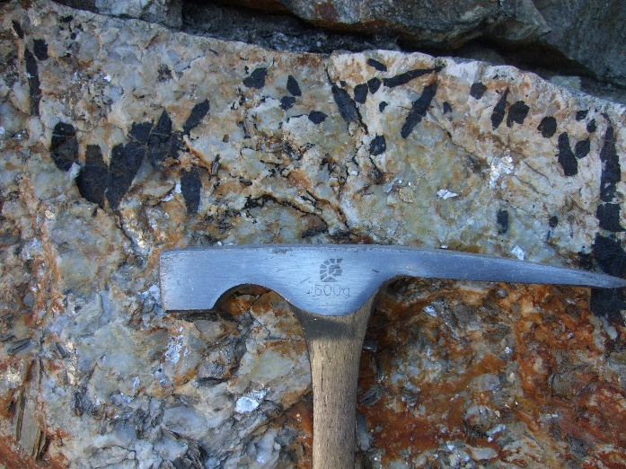
Digging Costeans

Slide 23
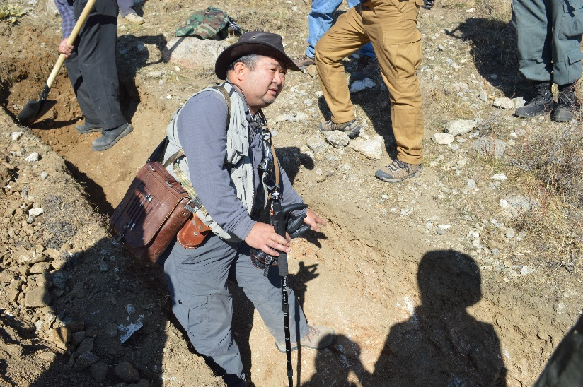
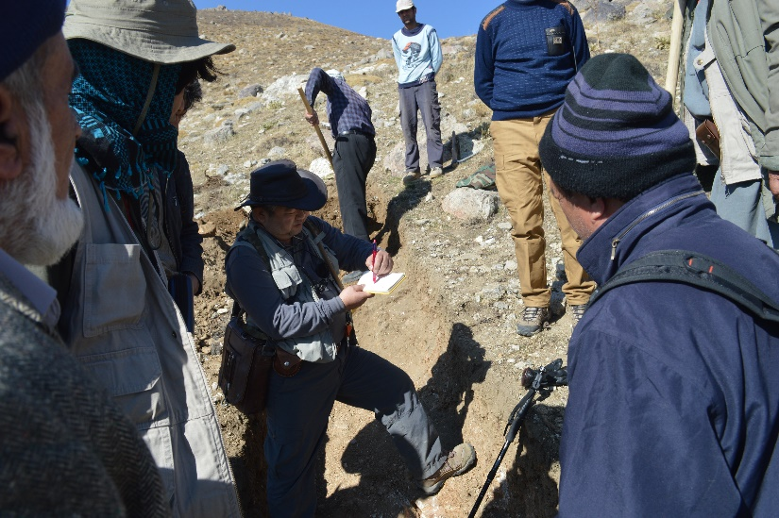
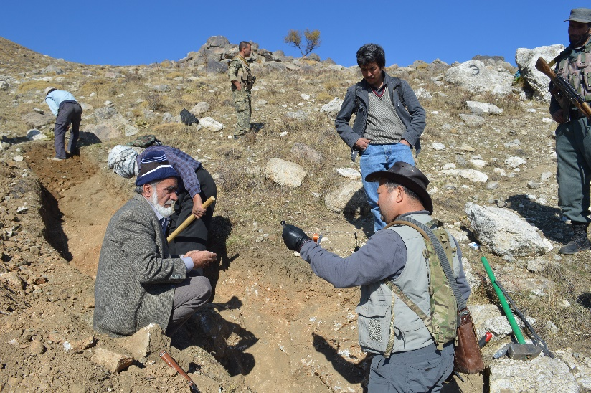
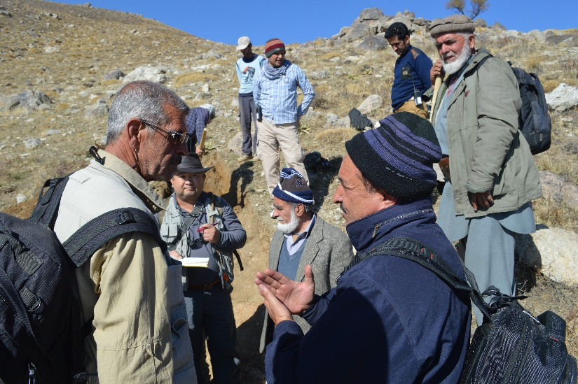
Costean mapping
Notes:
Even the dogs in Afghanistan knows to take risk to get somewhere…..

Slide 24
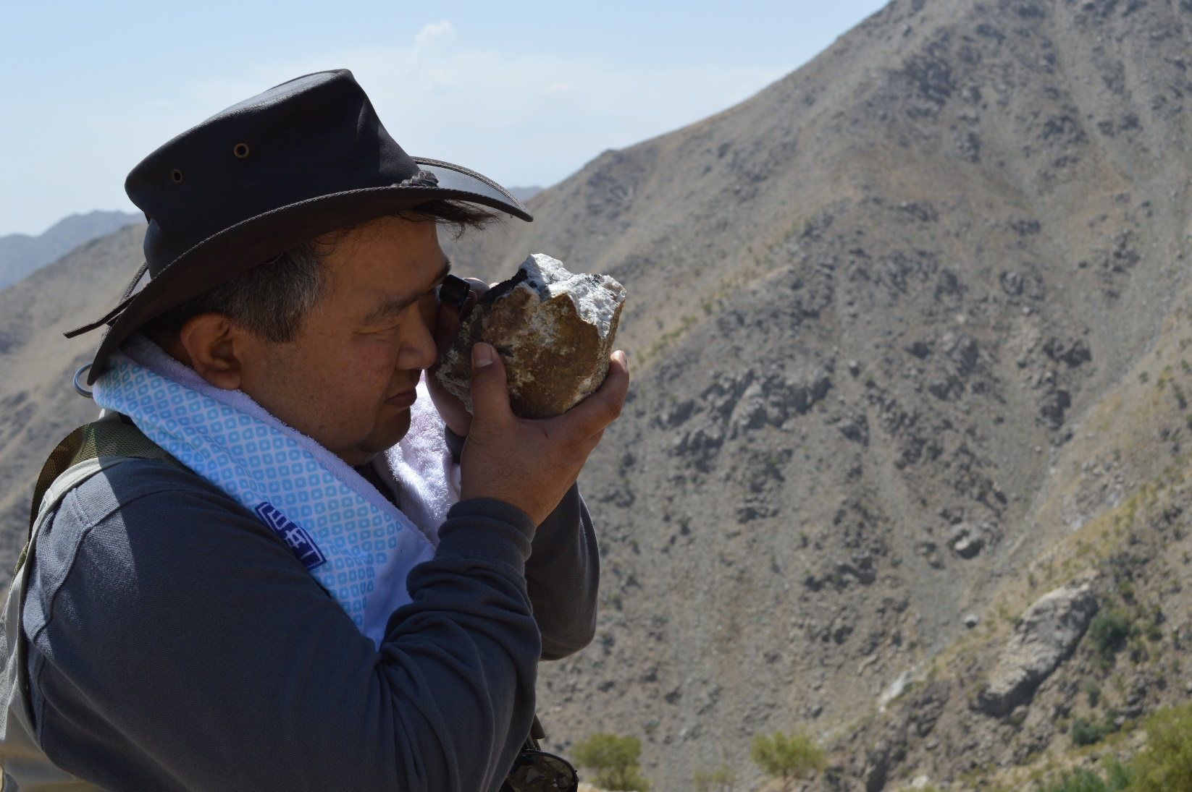
It is always good to look and feel the rocks, but

Slide 25
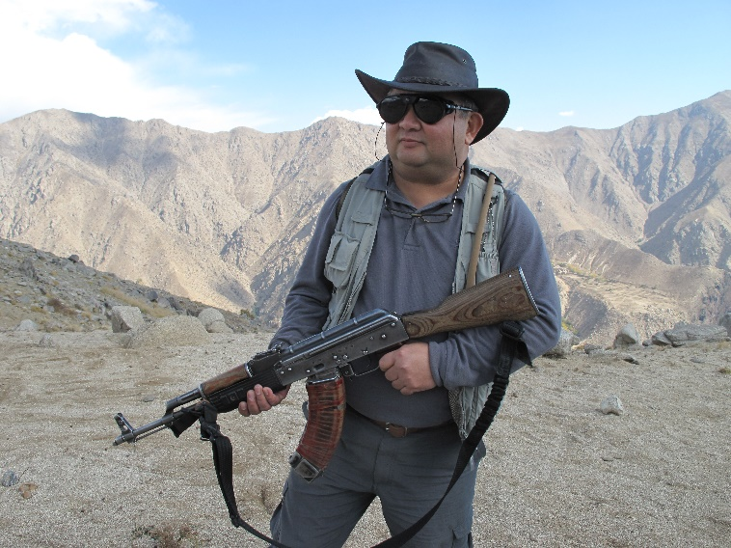
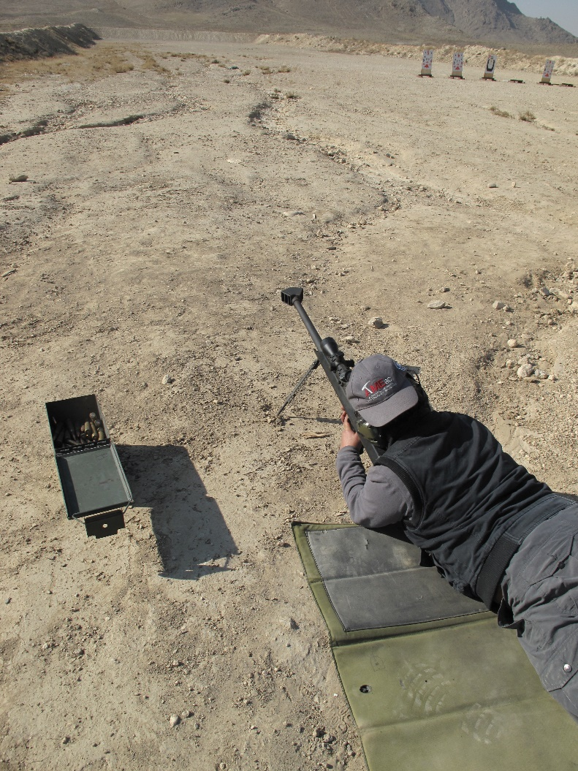
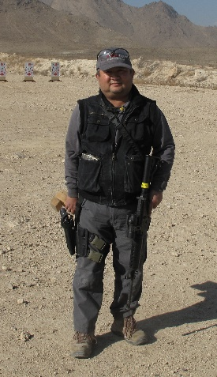
This give your adrenaline pumping….

Slide 26
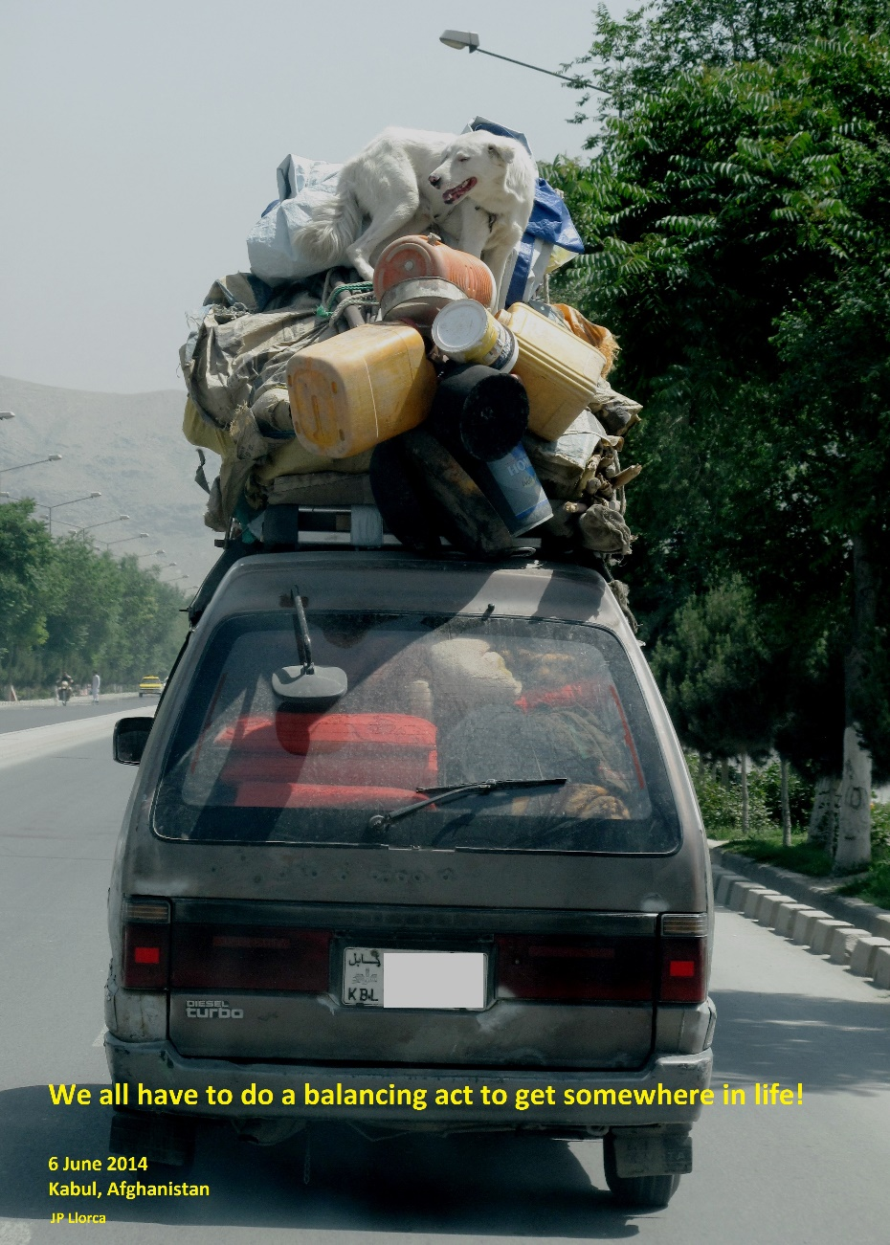
Life in the balance
Thank
you
for
listening
Notes:
Even the dogs in Afghanistan knows to take risk to get somewhere…..

