Slide 1
AGENDA AIG AGM 20 May 2015
Minutes of previous Annual General Meeting
President’s Report
Treasurer’s Report
Election of Council Members
Special Resolution

Slide 2
2. President’s Report

Slide 3
Membership Growth 3267 as of 1 May 2015
O/S - 417
QLD - 473
WA - 1370
Members
- 2220 (68%)
VIC - 258
NSW - 537

Slide 4
Benefits of AIG Membership
CP/QP for JORC and NI 43-101
Low membership fees and CPD events
Professional registration of geoscientists (RPGeo)
International recognition of qualifications
Free publications (AIG News, Bulletins, and Handbooks)
EduMine Campus discount
Extensive member benefits package:
Vehicle hire discounts
Discounted Home and investment loans
Motor vehicle purchase service
Qantas Club and Virgin Blue lounge membership
Residential, business and mobile phone plans
Motor vehicle insurance and finance
Travel services and travel brochures
Citibank credit card
Numerous lifestyle benefits, including gym membership, a wine club
Professional Indemnity and Public Liability Insurance
PL/PI Insurance

Slide 5
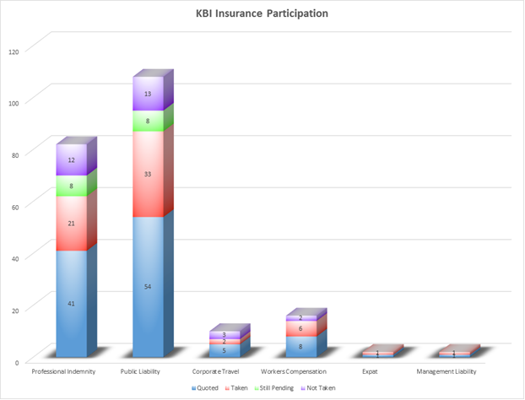
KBI Insurance Participation
85 % take up rate of members that proceed with insurance
336% increase in policies placed since last year’s AGM

Slide 6
Highlights 2014 - 2015
Membership growth
3181 at the end of 2014 to 3267 as of 1 May 2015
Communications
Online membership renewal and profile system
Appointment of a new editor for AIG News
Conversion of AIG News to a fully digital format
Online Bookstore
New initiatives
Mentoring program initiated by the new National Graduate Committee
Sponsored research
A realistic estimation of Australia’s Economically Recoverable Mineral Resources
UNCOVER “Roadmap” on future directions for exploration geoscience research
New Secretariat
Effective 1 July Secretariat Service Provider will be The Association Specialists (TAS) in Sydney

Slide 7
3. Treasurer’s Report

Slide 8
P & L
STATEMENT OF PROFIT & LOSS AND OTHER COMPREHENSIVE INCOME
FOR THE YEAR ENDED 31 DECEMBER 2014
 | Note | 2014 |  | 2013
 |  | $ |  | $
Revenue | 2 | 614,830 |  | 696,216
Expenses
Administration expenses |  | (149,266) |  | (105,279)
Audit, legal and consultancy expenses |  | (13,894) |  | (9,623)
Other expenses |  | (497,781) |  | (450,697)
Total Expenses |  | (660,941) |  | (565,599)
Current year (deficit) / surplus before income tax |  | (46,111) |  | 130,617
Income tax expense |  | - |  | -
(Deficit) / surplus after income tax expense attributable to members of the entity |  | (46,111) |  | 130,617
Other comprehensive income for the year, net of tax |  | - |  | -
Total comprehensive(loss)/ income for the year attributable to members of the entity |  | (46,111) |  | 130,617

Slide 9
Financial Position
STATEMENT OF FINANCIAL POSITION
AS AT 31 DECEMBER 2014
 | Note | 2014 |  | 2013
ASSETS |  | $ |  | $
CURRENT ASSETS
Cash and cash equivalents | 3 | 834,602 |  | 901,580
Trade and other receivables | 4 | 30,118 |  | 26,602
Other assets | 5 | 71,940 |  | 76,584
TOTAL CURRENT ASSETS |  | 936,660 |  | 1,004,766
NON-CURRENT ASSETS
Plant & Equipment | 6 | - |  | 2043
TOTAL NON-CURRENT ASSETS |  | - |  | 2043
TOTAL ASSETS |  | 936,660 |  | 1,006,809
CURRENT LIABILITIES
Trade and other payables | 7 | 35,279 |  | 59,317
TOTAL CURRENT LIABILITIES |  | 35,279 |  | 59,317
TOTAL LIABILITIES |  | 35,279 |  | 59,317
NET ASSETS |  | 901,381 |  | 947,492
EQUITY
Retained surplus |  | 901,381 |  | 947,492
TOTAL EQUITY |  | 901,381 |  | 947,492

Slide 10
4. Election of Council Members

Slide 11
Nominations
Councillors up for re-election:
Andrew Waltho
Jonathan Bell
Kaylene Camuti
Martin Robinson
Wayne Spilsbury
Vacancies (2)
Peter Lewis
Bob Findlay

Slide 12
5. Special Resolution to Amend Articles

Slide 13
Motion
RESOLUTION -
That the Articles of Association of Australian Institute of Geoscientists be amended as follows.
Delete
A notice may be given by the Council to any member either personally or by sending it by post to him at his registered address. Where a notice is sent by post, service of the notice shall be deemed to have been effected by properly addressing, prepaying, and posting a letter containing the notice, and to have been effected in the case of a notice of a meeting on the day after the date of its posting, and in any other case at the time at which the letter would be delivered in the ordinary course of post.
Insert
A notice may be given by the Council to any member either personally, by email or by sending it by post to him at his registered address. Where a notice is sent by post, service of the notice shall be deemed to have been effected by properly addressing, prepaying, and posting a letter containing the notice, and to have been effected in the case of a notice of a meeting on the day after the date of its posting, and in any other case at the time at which the letter would be delivered in the ordinary course of post.

Slide 14
Strategic Plan Questionnaire
What services do you as a member appreciate most from the AIG?
What are the most significant external trends likely to impact upon the AIG in the next five years?
To increase involvement of younger members what areas should the AIG develop?
What core activities or services could the AIG improve?
What other services, information or events do you think the AIG should consider providing to members?
What other services, information or events can the AIG provide to its members?
Do you think the AIG should consider developing closer working relationships with any other particular organisations? If so, which ones?
Should AIG take on a more active role in advocacy to government bodies?
Would you like to be involved in a sub-committee to drive the objectives from the Strategic Plan? If so, please provide your name and preferred contact details.

Slide 15
Meeting Adjourned
Thank you

Slide 16
Equity
STATEMENT OF CHANGES IN EQUITY
FOR THE YEAR ENDED 31 DECEMBER 2014
 | Retained
 | Earnings
 | $
Balance at 1 January 2013 | 816,875
Comprehensive Income
Surplus after income tax for the year | 130,617
Other comprehensive income for the year, net of tax | -
Total comprehensive income attributable to members of the entity | 130,617
Balance at 31 December 2013 | 947,492
Comprehensive Income
(Deficit) after income tax for the year | (46,111)
Other comprehensive income for the year, net of tax | -
Total comprehensive loss attributable to members of the entity | (46,111)
Balance at 31 December 2014 | 901,381

Slide 17
Cash Flow
STATEMENT OF CASH FLOWS
FOR THE YEAR ENDED 31 DECEMBER 2014
 | Note | 2014 |  | 2013
 |  | $ |  | $
CASH FLOW FROM OPERATING ACTIVITIES
Receipts from members and customers |  | 589,213 |  | 851,654
Payments to suppliers and contractors |  | (677,924) |  | (560,700)
Interest received |  | 22,101 |  | 20,936
Net cash (used in) / provided by operating activities | 8 | (66,610) |  | 311,890
CASH FLOW FROM INVESTING ACTIVITIES
Payments for property, plant & equipment |  | (368) |  | (1,453)
Net cash used in investing activities |  | (368) |  | (1,453)
Net increase in cash held |  | (66,978) |  | 310,437
Cash and cash equivalents at beginning of the financial year |  | 901,580 |  | 591,143
Cash and cash equivalents at end of the financial year |  | 834,602 |  | 901,580

